Slide 1
String conversion and Formating in PHP
BY
B.AKILANDESWARI, M.C.A., M.PHIL., B.ED., PDIT,
ASSISTANT PROFESSOR, DEPARTMENT OF COMPUTER SCIENCE, SIGC, TRICHY-2

Slide 2
To convert an Integer Into a String in PHP
The PHP strval() function is used to convert an Integer Into a String in PHP. There are many other methods to convert an integer into a string.
Methods:
Using strval() function.
Using inline variable parsing.
Using explicit Casting.

Slide 3
<?php
$var_name = 2;
// converts integer into string
$str = strval($var_name);
// prints the value of above variable as a string
echo "Welcome $str PHP";
?>
<?php
$var_name = 2;
// prints the value of above variable
// as a string
echo "Welcome $var_name PHP-";
?>
<?php
$var_name = 2;
//Typecasting Integer into string
$str = (string)$var_name;
// prints the value of above variable as a string
echo "Welcome $str PHP";
?>

Slide 4
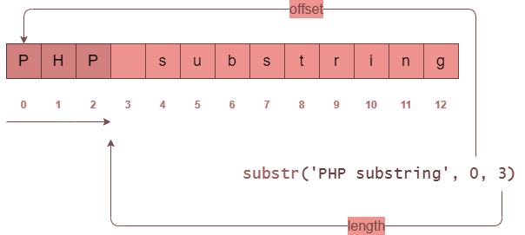
SUBSTR( )
<?php
$s = 'PHP substring';
$result = substr($s, 0, 3);
echo $result;// PHP

Slide 5
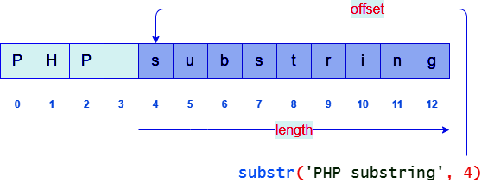
SUBSTR( )
<?php
$s = 'PHP substring';
$result = substr($s, 4);
echo $result; // substring

Slide 6
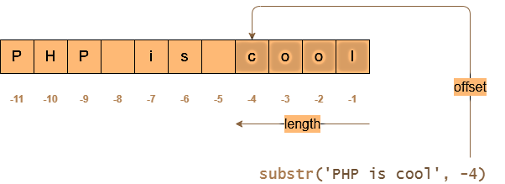
SUBSTR( )
<?php
$s = 'PHP is cool';
$result = substr($s, -4);
echo $result; // cool

Slide 7
Use substr_replace
Substr_replace - Syntax
substr_replace(string,replacement,start,length)
Parameter | Description
string | Required. Specifies the string to check
replacement | Required. Specifies the string to insert
start | Required. Specifies where to start replacing in the stringA positive number - Start replacing at the specified position in the string Negative number - Start replacing at the specified position from the end of the string 0 - Start replacing at the first character in the string
length | Optional. Specifies how many characters should be replaced. Default is the same length as the string.A positive number - The length of string to be replaced A negative number - How many characters should be left at end of string after replacing 0 - Insert instead of replace
<?php
echo substr_replace("Hello world","earth",6);
?>
<?php
echo substr_replace("Hello world","earth",-5);
?>
<?php
echo substr_replace("world","Hello ",0,0);
?>
<?php
$replace = array("1: AAA","2: AAA","3: AAA");
echo implode("<br>",substr_replace($replace,'BBB',3,3));
?>
Hello earth
Hello earth
Hello world
1: BBB
2: BBB
3: BBB
Start replacing at the 6th position in the string (replace "world" with "earth"):
Start replacing at the 5th position from the end of the string (replace "world" with "earth"):

Slide 8
FORMATING STRING IN PHP

Slide 9
<!DOCTYPE html>
<html><body><?php $num1 = 123456789; $num2 = -123456789;
$char = 50; // The ASCII Character 50 is 2
printf("%%b = %b <br>",$num1); // Binary number
printf("%%c = %c <br>",$char); // The ASCII Character
printf("%%d = %d <br>",$num1); // Signed decimal number
printf("%%d = %d <br>",$num2); // Signed decimal number
printf("%%e = %e <br>",$num1); // Scientific notation (lowercase)
printf("%%E = %E <br>",$num1); // Scientific notation (uppercase)
printf("%%u = %u <br>",$num1); // Unsigned decimal number (positive)
printf("%%u = %u <br>",$num2); // Unsigned decimal number (negative)
printf("%%f = %f <br>",$num1); // Floating-point number (local settings aware)
printf("%%F = %F <br>",$num1); // Floating-point number (not local sett aware)
printf("%%g = %g <br>",$num1); // Shorter of %e and %f
printf("%%G = %G <br>",$num1); // Shorter of %E and %f
printf("%%o = %o <br>",$num1); // Octal number
printf("%%s = %s <br>",$num1); // String
printf("%%x = %x <br>",$num1); // Hexadecimal number (lowercase)
printf("%%X = %X <br>",$num1); // Hexadecimal number (uppercase)
printf("%%+d = %+d <br>",$num1); // Sign specifier (positive)
printf("%%+d = %+d <br>",$num2); // Sign specifier (negative) ?></body></html>
OUTPUT
%b = 111010110111100110100010101
%c = 2
%d = 123456789
%d = -123456789
%e = 1.234568e+8
%E = 1.234568E+8
%u = 123456789
%u = 18446744073586094827
%f = 123456789.000000
%F = 123456789.000000
%g = 1.23457e+8
%G = 1.23457E+8
%o = 726746425
%s = 123456789
%x = 75bcd15
%X = 75BCD15
%+d = +123456789
%+d = -123456789

Slide 10
Use trim
The trim() function removes whitespace and other predefined characters from both sides of a string.
Related functions:
ltrim() - Removes whitespace or other predefined characters from the left side of a string
rtrim() - Removes whitespace or other predefined characters from the right side of a string
<!DOCTYPE html>
<html>
<body>
<?php
$str = "Hello World!";
echo $str . "<br>";
echo trim($str,"Hed!");
?>
</body>
</html>
Add more information here as needed

Slide 11
STRING FUNCTIONS IN PHP

Slide 12
<!DOCTYPE html>
<html><body><?php $num1 = 123456789; $num2 = -123456789;
$char = 50; // The ASCII Character 50 is 2
printf("%%b = %b <br>",$num1); // Binary number
printf("%%c = %c <br>",$char); // The ASCII Character
printf("%%d = %d <br>",$num1); // Signed decimal number
printf("%%d = %d <br>",$num2); // Signed decimal number
printf("%%e = %e <br>",$num1); // Scientific notation (lowercase)
printf("%%E = %E <br>",$num1); // Scientific notation (uppercase)
printf("%%u = %u <br>",$num1); // Unsigned decimal number (positive)
printf("%%u = %u <br>",$num2); // Unsigned decimal number (negative)
printf("%%f = %f <br>",$num1); // Floating-point number (local settings aware)
printf("%%F = %F <br>",$num1); // Floating-point number (not local sett aware)
printf("%%g = %g <br>",$num1); // Shorter of %e and %f
printf("%%G = %G <br>",$num1); // Shorter of %E and %f
printf("%%o = %o <br>",$num1); // Octal number
printf("%%s = %s <br>",$num1); // String
printf("%%x = %x <br>",$num1); // Hexadecimal number (lowercase)
printf("%%X = %X <br>",$num1); // Hexadecimal number (uppercase)
printf("%%+d = %+d <br>",$num1); // Sign specifier (positive)
printf("%%+d = %+d <br>",$num2); // Sign specifier (negative) ?></body></html>
OUTPUT
%b = 111010110111100110100010101
%c = 2
%d = 123456789
%d = -123456789
%e = 1.234568e+8
%E = 1.234568E+8
%u = 123456789
%u = 18446744073586094827
%f = 123456789.000000
%F = 123456789.000000
%g = 1.23457e+8
%G = 1.23457E+8
%o = 726746425
%s = 123456789
%x = 75bcd15
%X = 75BCD15
%+d = +123456789
%+d = -123456789

Slide 13
PHP str_replace
str_replace(find, replace, str, count)
<?php
$str = 'Hello there';
$new_str = str_replace('Hello', 'Hi', $str);
echo $new_str . '<br>'; // Hi there
echo $str . '<br>'; // Hello there
The PHP str_replace() function returns a new string with all occurrences of a substring replaced with another string.
Hi there
Hello there

Slide 14
STR_REPLACE( )
<?php
$str = 'bye bye bye';
$new_str = str_replace('bye', ‘hai', $str);
echo $new_str; // hey hey hey
hai hai hai

Slide 15
STR_REPLACE( )
<?php
$str = 'Hi, hi, hi';
$new_str = str_replace('hi', 'bye', $str, $count);
echo $count; // 2
OUTPUT
2

Slide 16
STR_REPLACE( )
<?php
$str = 'The quick brown fox jumps over the lazy dog';
$animals = ['fox', 'dog'];
$new_animals = ['wolf', 'cat'];
$new_str = str_replace($animals, $new_animals, $str);
echo $new_str;
OUTPUT
The quick brown wolf jumps over the lazy cat

Slide 17
STR_REPLACE( )
<?php
$str = 'apple';
$fruits = ['apple', 'orange', 'banana'];
$replacements = ['orange', 'banana', 'strawberry'];
$new_str = str_replace($fruits, $replacements, $str, $count);
echo $new_str; // strawberry
echo $count; // 3
OUTPUT
Strawberry 3

Slide 18
THANK YOU

