Slide 1

AJAX
AJAX stands for Asynchronous JavaScript
and XML
BY
B.AKILANDESWARI, M.C.A., M.PHIL., B.ED., PDIT,
ASSISTANT PROFESSOR,
DEPARTMENT OF COMPUTER SCIENCE,
SIGC, TRICHY-2

Slide 2

Introduction
It is a technique used for creating dynamic and responsive web pages without the need for page refresh.
AJAX enables a web page to send and receive data asynchronously from a server, allowing for quick updates and interaction with the user.
PHP AJAX combines AJAX techniques with PHP, a popular server-side scripting language.
With PHP AJAX, web developers can create fast and responsive web applications that can communicate with a server in real-time.

Slide 3
Using PHP, Ajax, and Databases to Create Dynamic Web Pages
PHP, Ajax, and databases can be used together to create dynamic web pages that can provide a rich user experience. To achieve this, you need to follow the following steps:
Establish a connection to the database using PHP
Retrieve data from the database using PHP
Use Ajax to update the web page with the retrieved data

Slide 4
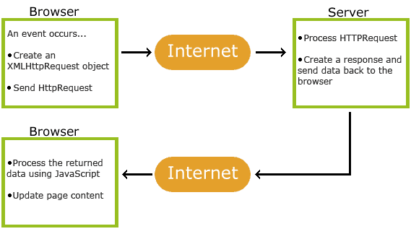
HOW AJAX WORKS
1. An event occurs in a web page (the page is loaded, a button is clicked)
2. An XMLHttpRequest object is created by JavaScript
3. The XMLHttpRequest object sends a request to a web server
4. The server processes the request
5. The server sends a response back to the web page
6. The response is read by JavaScript
7. Proper action (like page update) is performed by JavaScript

Slide 5
The XMLHttpRequest Object
The XMLHttpRequest Object
All modern browsers support the XMLHttpRequest object.
The XMLHttpRequest object can be used to exchange data with a server behind the scenes. This means that it is possible to update parts of a web page, without reloading the whole page.
Create an XMLHttpRequest Object
All modern browsers (Chrome, Firefox, Edge (and IE7+), Safari, Opera) have a built-in XMLHttpRequest object.
Syntax for creating an XMLHttpRequest object:
variable = new XMLHttpRequest();
Example
var xhttp = new XMLHttpRequest();

Slide 6
XMLHttpRequest object Methods
Method | Description
new XMLHttpRequest() | Creates a new XMLHttpRequest object
abort() | Cancels the current request
getAllResponseHeaders() | Returns header information
getResponseHeader() | Returns specific header information
open(method,url,async,user,psw) | Specifies the request method: the request type GET or POST url: the file location async: true (asynchronous) or false (synchronous) user: optional user name psw: optional password
send() | Sends the request to the server Used for GET requests
send(string) | Sends the request to the server. Used for POST requests
setRequestHeader() | Adds a label/value pair to the header to be sent

Slide 7
XMLHttpRequest Object Properties
Property | Description
onreadystatechange | Defines a function to be called when the readyState property changes
readyState | Holds the status of the XMLHttpRequest. 0: request not initialized 1: server connection established 2: request received 3: processing request 4: request finished and response is ready
responseText | Returns the response data as a string
responseXML | Returns the response data as XML data
status | Returns the status-number of a request 200: "OK" 403: "Forbidden" 404: "Not Found" For a complete list go to the Http Messages Reference
statusText | Returns the status-text (e.g. "OK" or "Not Found")

Slide 8
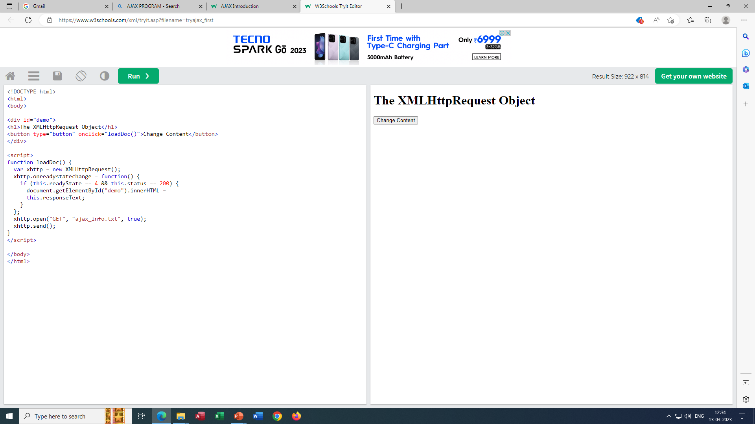
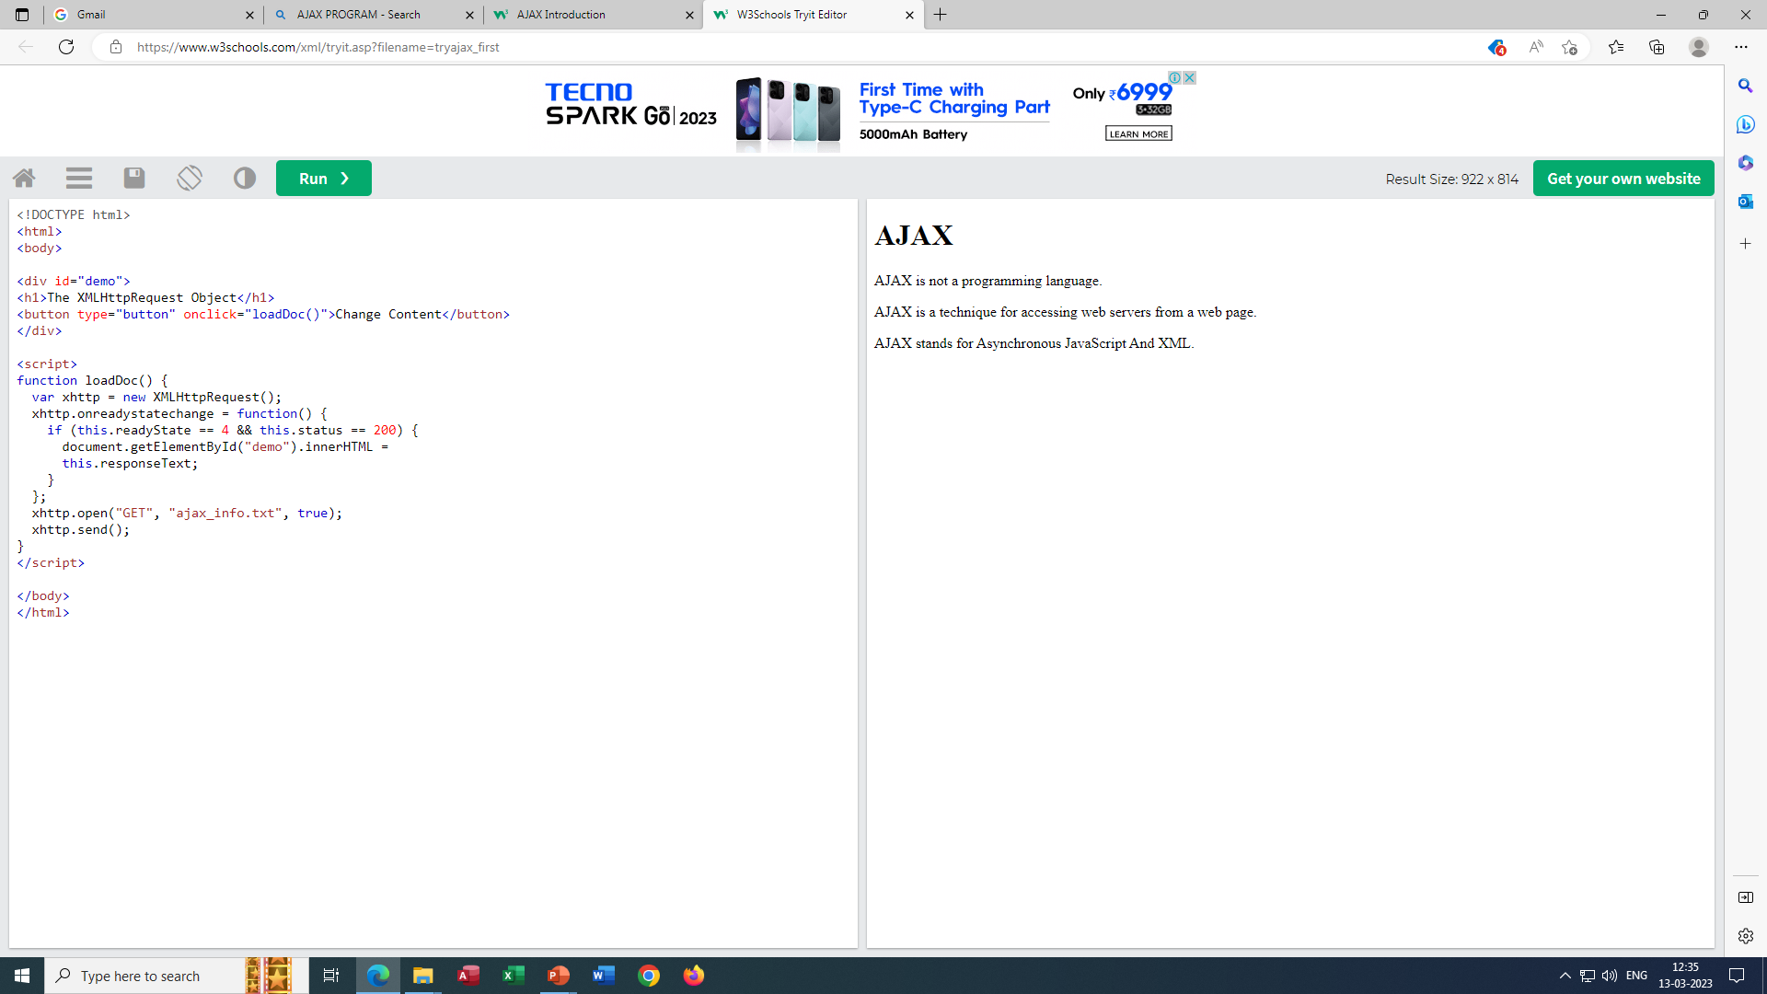
AJAX PROGRAM
<!DOCTYPE html>
<html>
<body>
<div id="demo">
<h2>Let AJAX change this text</h2>
<button type="button" onclick="loadDoc()">Change Content</button>
</div>
</body>
</html>
<script>
function loadDoc() {
var xhttp = new XMLHttpRequest();
xhttp.onreadystatechange = function() {
if (this.readyState == 4 && this.status == 200) {
document.getElementById("demo").innerHTML =
this.responseText;
}
};
xhttp.open("GET", "ajax_info.txt", true);
xhttp.send();
}
</script></body></html>
The "ajax_info.txt" file used in the example above, is a simple text file and looks like this:
<h1>AJAX</h1>
<p>AJAX is not a programming language.</p>
<p>AJAX is a technique for accessing web servers from a web page.</p>
<p>AJAX stands for Asynchronous JavaScript And XML.</p>

Slide 9

Thank you
B.Akilandeswari
Asst. Prof, SIGC,
Trichy-1
akilandeswarib@sigc.edu

